Slide 1
RESUME CLASSIFICATION

Slide 2
PROJECT OBJECTIVE
The document classification solution should significantly reduce the manual human effort in the HRM. It should achieve a higher level of accuracy and automation with minimal human intervention
Project Group Members:-
Ms. Ashwini Nanasaheb Gangurde
Mr. Saurabh Dandriyal
Ms. Akanksha Ashok Shetty
Mr. Hitesh B. Patil
Ms. Aishwarya Kishor Patil
Ms. Parankusham Vindhya
Shubham Anil Patil

Slide 3
PROJECT FLOW
EDA
MODEL BUILDING
DEPLOYMENT

Slide 4
EXPLORATORY DATA ANALYSIS

Slide 5
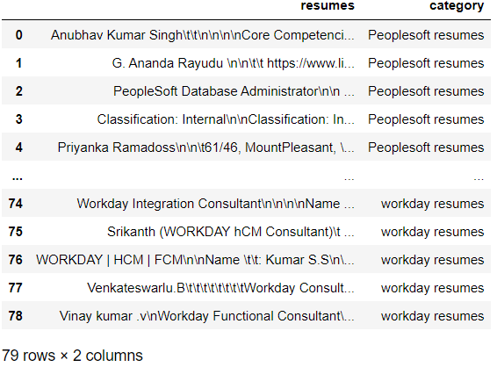
EXPLORATORY DATA ANALYSIS
Data is extracted with the help of textract.

Slide 6
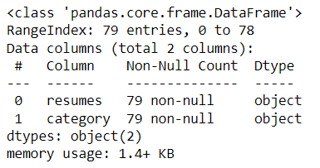
EXPLORATORY DATA ANALYSIS
Following are the unique categories in the dataset
79 resume found in the data and none of them is blank

Slide 7
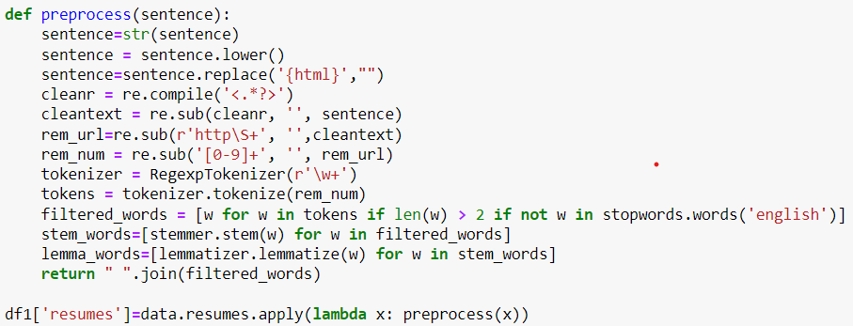
EXPLORATORY DATA ANALYSIS
Creating a function to perform all the necessary actions on the crude data
RegexpTokenizer to extract the stream of tokens with the help of regular expressions
Removing the mentioned symbols and replacing the old string with new string(regex)
Converted every letter to lowercase
Removing the mentioned symbols and replacing the old string with new string(regex)
Removing the stop words
Removing {html}
Replacing preexisted ones with new curated string (regex method)
Tokenizing using RegexpTokenizer
Removed the symbols
Lemmatizing the words using lemmatizer
Joining back the filtered words
Stemming the words using porter stemmer

Slide 8
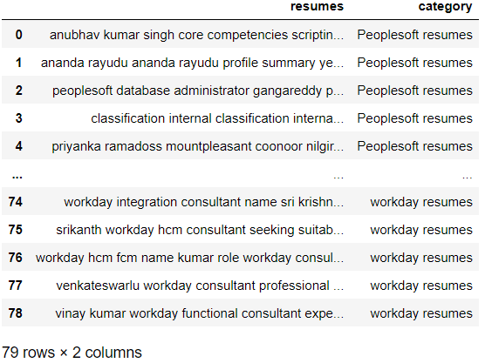
EXPLORATORY DATA ANALYSIS
Cleaned data after performing all the operations

Slide 9
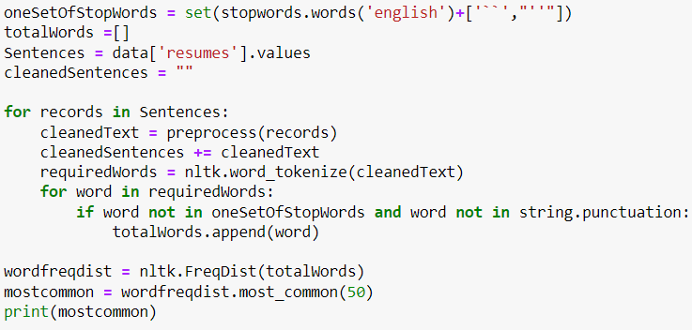
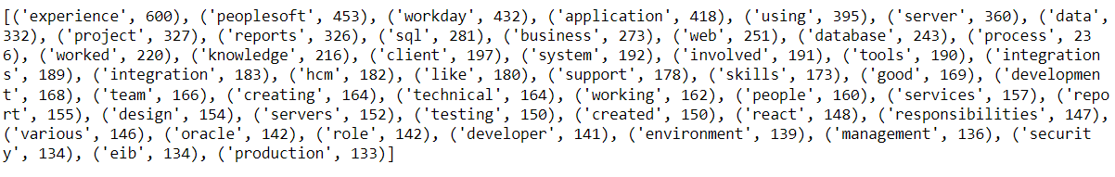
EXPLORATORY DATA ANALYSIS
Data Exploration

Slide 10
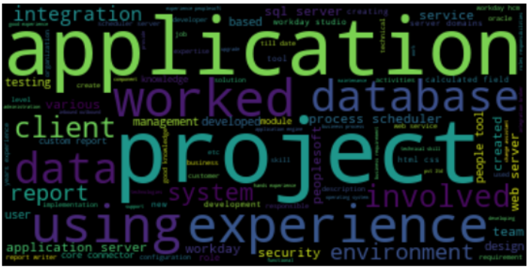
EXPLORATORY DATA ANALYSIS
Artistically arranging the words using WORDCLOUD

Slide 11
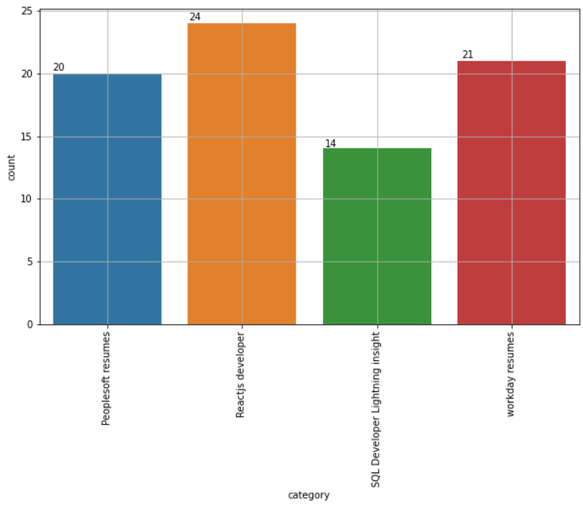
EXPLORATORY DATA ANALYSIS
Exact count of all 4 categories in the data

Slide 12
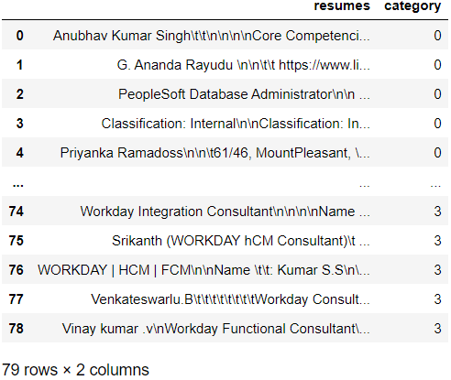
EXPLORATORY DATA ANALYSIS
Encoding the category column using Label Encoder
The four categories are Encoded as follows
0
Peoplesoft Resumes
1
Reactjs Developer
2
SQL Developer lightening insight
3
Workday Resumes

Slide 13
MODEL BUILDING

Slide 14
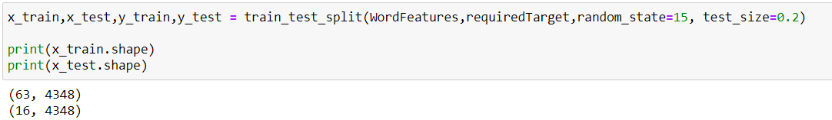
MODEL BUILDING
Train-Test Split

Slide 15
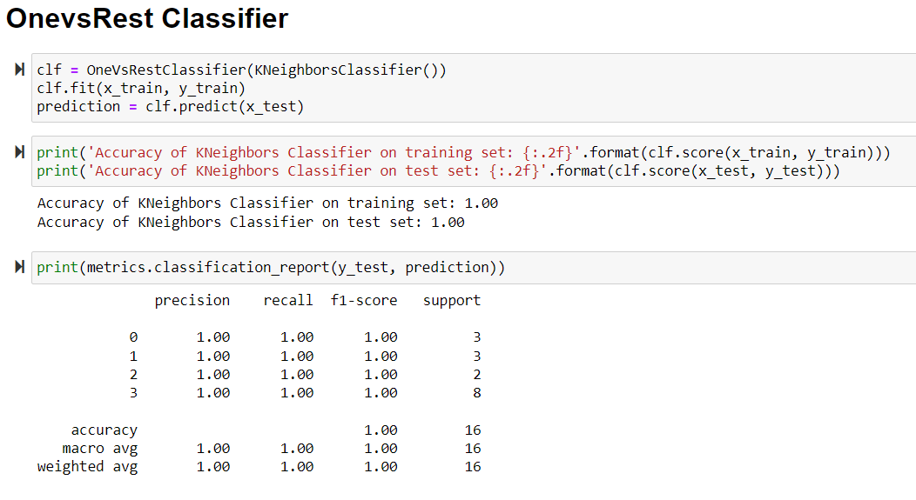
OnevsRest Classifier (KNN)

Slide 16
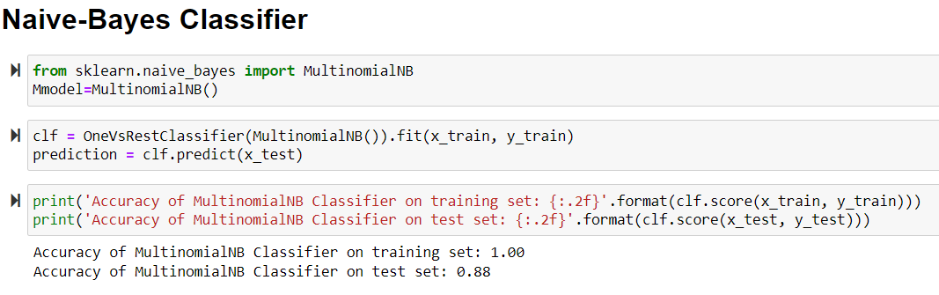
Naïve-Bayes Classifier

Slide 17
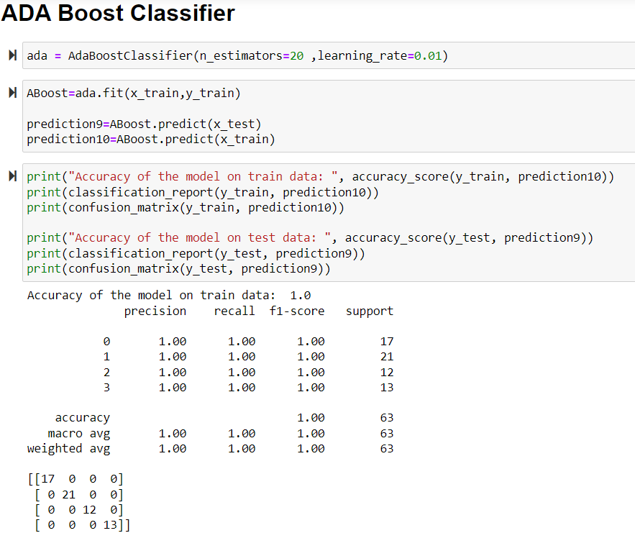
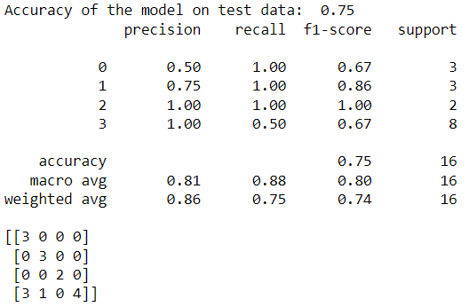
ADA Boost Classifier

Slide 18
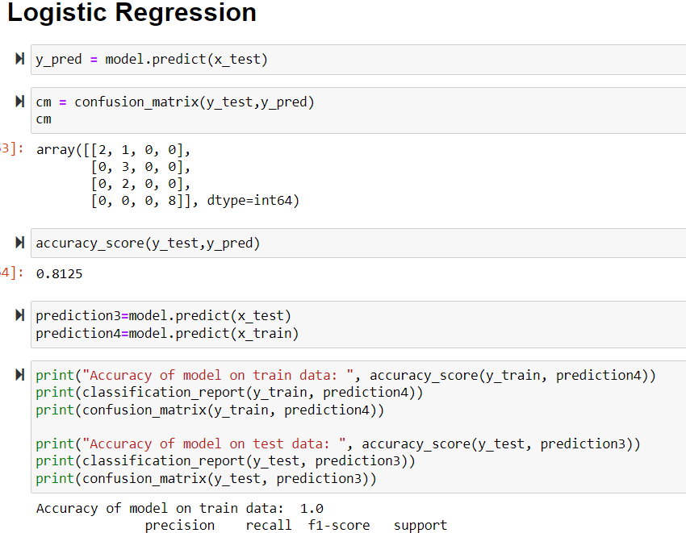
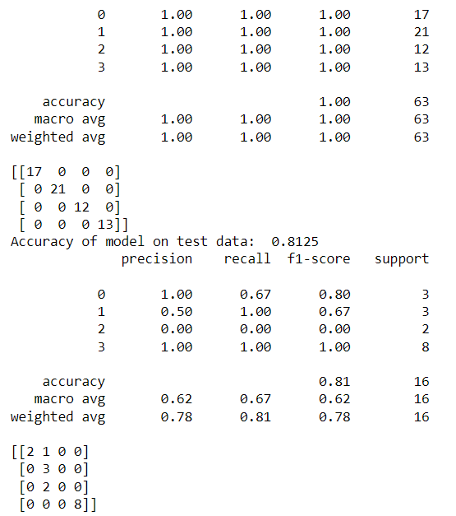
Logistic Regression

Slide 19
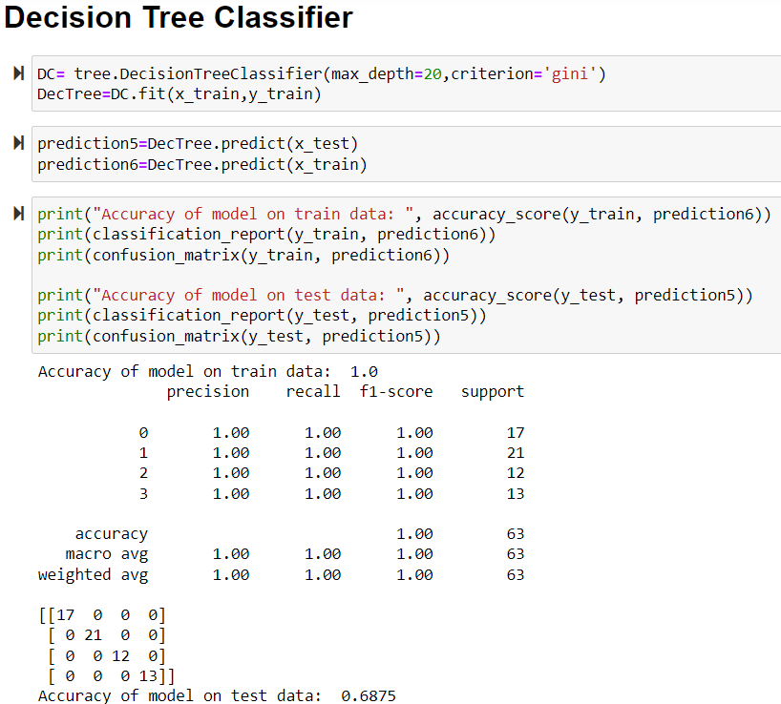
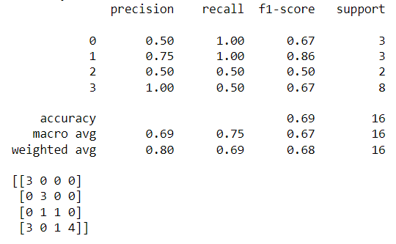
Decision Tree Classifier

Slide 20
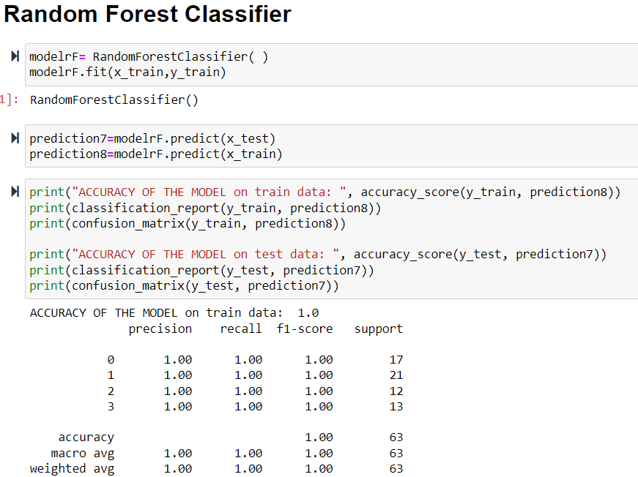
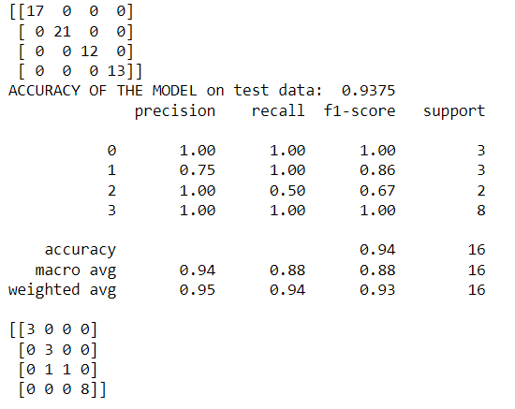
Random Forest Classifier

Slide 21
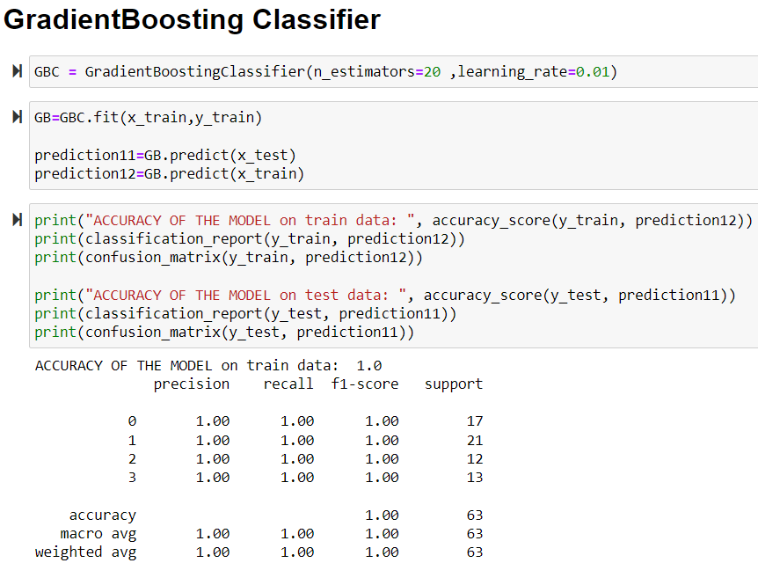
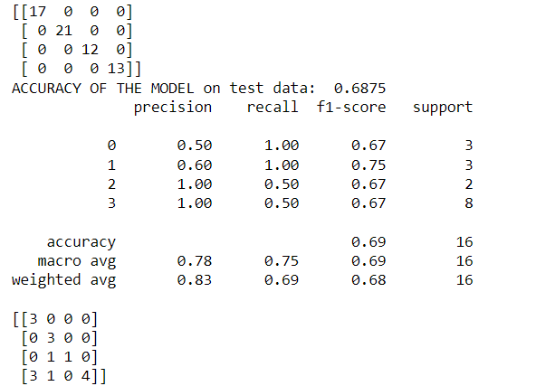
Gradient Boosting

Slide 22
MODEL BUILDING SUMMARY
Model Name | Training Accuracy | Testing Accuracy
OnevsRest Classifier | 100% | 100%
Naive-Bayes Classifier | 100% | 88%
ADA Boost Classifier | 100% | 75%
Logistic Regression | 100% | 81.25%
Decision Tree Classifier | 100% | 68.75%
Random Forest Classifier | 100% | 93.75%
GradientBoosting Classifier | 100% | 68.75%

Slide 23
DEPLOYMENT

Slide 24
DEPLOYMENT
Integration of Machine Learning Model into an existing production environment where the user can enter the input to generate output & later it can be used in making business decisions.
In Python, we can achieve the same by using different frameworks
Django
Flask
Streamlit
Rshiny is another powerful extension based on R to build interactive dashboards

Slide 25
DEPLOYMENT USING STREAMLIT
Streamlit is an open-source app framework for Machine Learning and Data Science teams.
Reasons to use Streamlit:
Build an app in few lines of code and with simple API .
It doesn't require any web development knowledge
Deploy the code instantly and see the changes simultaneously by saving the source code
It's a open source framework

Slide 26
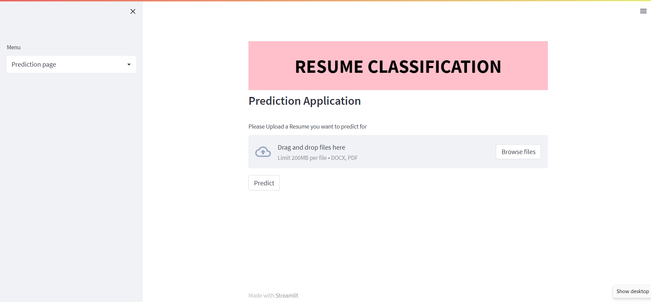
WEB INTERFACE OF STREAMLIT DEPLOYMENT

Slide 27
THANK YOU

